Slide 1
Zero Emissions Vehicles Be Surprised
Social media community education content for car dealers in the ZEV Subsidy program to share
ZEV Be Surprised has been developed by DELWP Energy
December 2021

Slide 2
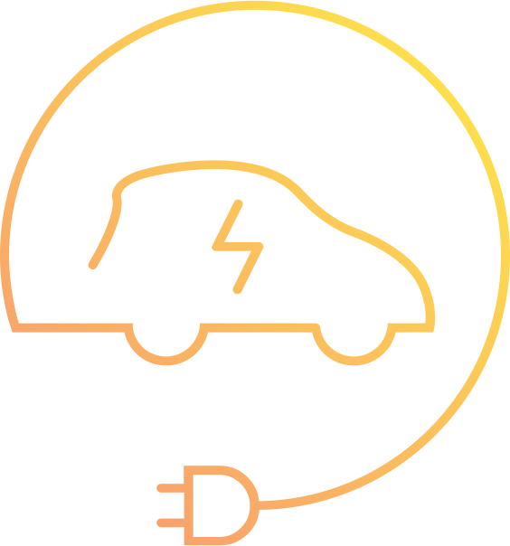
Zero Emissions Vehicles – Be Surprised
Welcome to Be Surprised
The Zero Emissions Vehicles (ZEVs) – Be Surprised social media content on these pages is designed to encourage community understanding of the broad benefits of ZEVs and to promote the Victorian Government’s ZEV programs.
The Victorian Government has set a target that by 2030, half of all light vehicle sales in Victoria will be ZEVs. To deliver this, it developed the ZEV Roadmap which is supported by a $100 million dollar package of policies and programs. The Roadmap is helping Victoria lead the adoption of ZEVs in Australia and position the state to take full advantage of the emerging global shift towards this exciting technology.
We encourage you to share this content to help spread the word and get Victorians driving the future of transport sooner. This content has a focus on battery electric vehicles.
For more ZEV Subsidy promotional material, see www.solar.vic.gov.au/promotional-resources-zero-emissions-vehicle-industry

Slide 3
Be Surprised post 1 – dollars saved
File: ZEV Be Surprised – dollars saved.mp4
Post copy:
Did you know there are around 31 passenger electric vehicle models available to buy in Australia right now? With an additional 27 models expected to be available by the end of 2022, it’s never been easier to make the switch ⚡
You could also save as much as $10,000 in the first 5 years of ownership, combining the $3,000 purchase subsidy and adding on the estimated yearly savings of $1,600 for fuel, maintenance, and registration 💰
Interested in going electric? Learn more at: www.energy.vic.gov.au/zev-facts
Did you know there are around 31 passenger electric vehicle models available to buy in Australia right now? With an additional 27 models expected to be available by the end of 2022, it’s never been easier to make the switch ⚡ You could also save as much as $10,000 in the first 5 years of ownership, combining the $3,000 purchase subsidy and adding on the estimated yearly savings of $1,600 for fuel, maintenance, and registration 💰 Interested in going electric? Learn more at: www.energy.vic.gov.au/zevfacts
Mock-up only. Please hover over the image to press play

Slide 4
Be Surprised post 2 – how far
File: ZEV Be Surprised – how far.mp4
Post copy:
How far can you travel with an electric vehicle on one charge? Quite a distance! 🚙
Many electric vehicle models currently available in Australia can travel at least 350-450 kilometres on a single charge – and with Victorians travelling an average of just 38 kilometres a day, that’s more than enough to get you where you need to go through the week 🛣️
With more investment in charging infrastructure, adding to the network already on our highways, in regional towns and at our favourite tourist spots, you won’t ever have to worry about running out of charge ⚡
See how far you can go with an electric vehicle here: www.energy.vic.gov.au/zev-facts
How far can you travel with an electric vehicle on one charge? Quite a distance! 🚙 Many electric vehicle models currently available in Australia can travel at least 350-450 kilometres on a single charge – and with Victorians travelling an average of just 38 kilometres a day, that’s more than enough to get you where you need to go through the week 🛣️ With more investment in charging infrastructure, adding to the network already on our highways, in regional towns and at our favourite tourist spots, you won’t ever have to worry about running out of charge ⚡ See how far you can go with an electric vehicle here: www.energy.vic.gov.au/zevfacts
Mock-up only. Please hover over the image to press play

Slide 5
Be Surprised post 3 – performance
File: ZEV Be Surprised – performance.mp4
Post copy:
Fact: Electric vehicles stack up pretty well compared to the competition ✅
On top of the environmental and cost benefits of owning an electric vehicle, you’ll also find that they outperform petrol equivalents in other ways.
🚙 Electric vehicles deliver great acceleration, making them nimble around town and giving confidence when merging onto the freeway.
🛍️ The placement of batteries and the electric motor takes up less space than a standard petrol equivalent – leaving more room for groceries or the camping gear.
Take a more detailed look into electric vehicles here: www.energy.vic.gov.au/zev-facts
Fact: Electric vehicles stack up pretty well compared to the competition ✅ On top of the environmental and cost benefits of owning an electric vehicle, you’ll also find that they outperform petrol equivalents in other ways. 🚙 Electric vehicles deliver great acceleration, making them nimble around town and giving confidence when merging onto the freeway. 🛍️ The placement of batteries and the electric motor takes up less space than a standard petrol equivalent – leaving more room for groceries or the camping gear. Take a more detailed look into electric vehicles here: www.energy.vic.gov.au/zevfacts
Mock-up only. Please hover over the image to press play

Slide 6
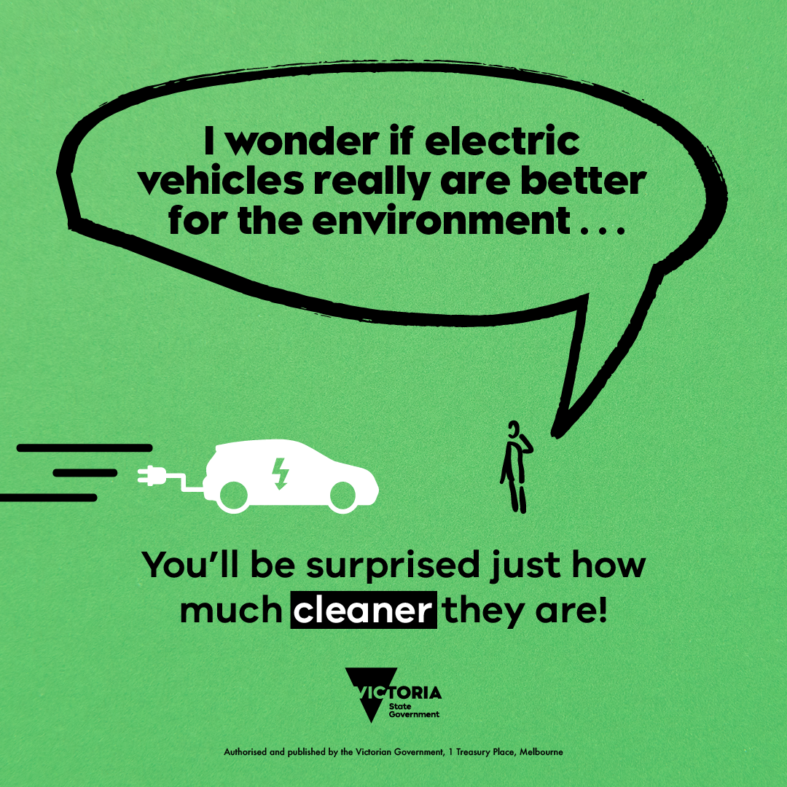
Be Surprised post 4 – cleaner
File: ZEV Be Surprised – cleaner.png
Post copy:
Are electric vehicles better for the environment? Yes 💚
Electric vehicles have zero exhaust emissions making them better for the environment – and our health – than their standard petrol equivalent 🚗
And if you have solar electricity, you have the potential to drive completely carbon neutral, charging your car from the clean power you generate through the day 🌞
Get the facts on electric vehicles at: www.energy.vic.gov.au/zev-facts
Are electric vehicles better for the environment? Yes 💚
Electric vehicles have zero exhaust emissions making them better for the environment – and our health – than their standard petrol equivalent 🚗
And if you have solar electricity, you have the potential to drive completely carbon neutral, charging your car from the clean power you generate through the day 🌞
Get the facts on electric vehicles at www.energy.vic.gov.au/zevfacts
Mock-up only

Slide 7
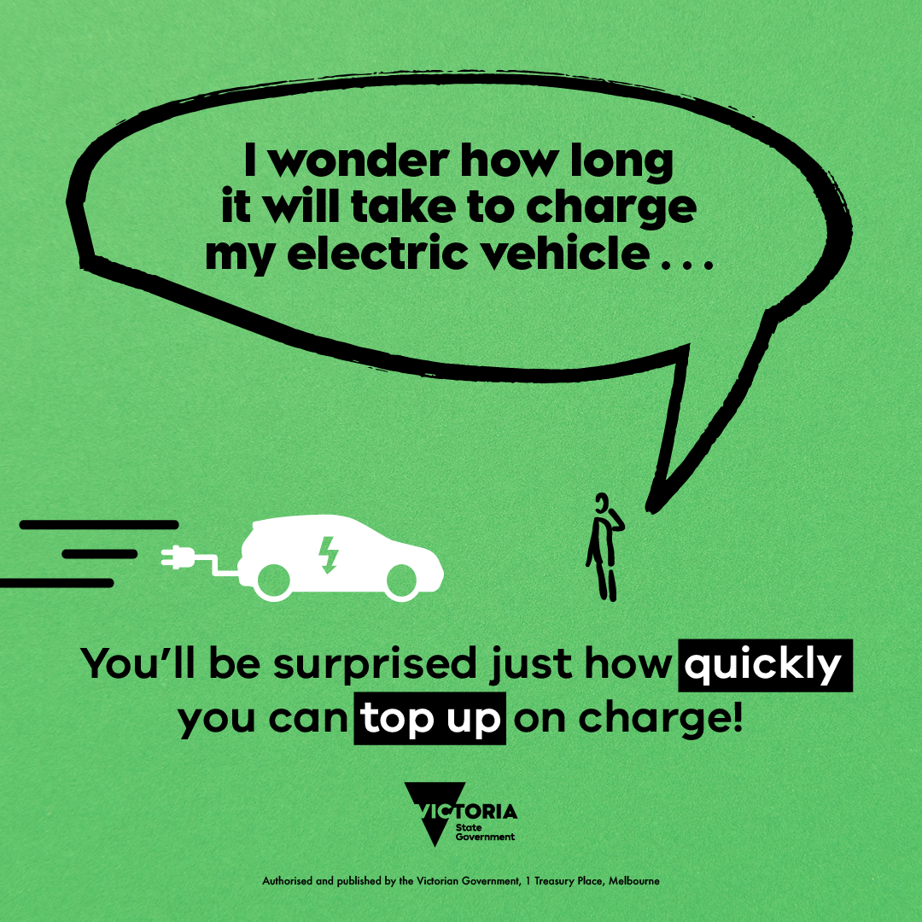
Be Surprised post 5 – top up
File: ZEV Be Surprised – top up.png
Post copy:
How long does it take to charge an electric vehicle? 🤔
Some of the fastest chargers can provide 400km of range in 15 minutes! At home, the average charging time for an electric vehicle is 6 to 8 hours, meaning you can easily charge your car at home overnight - just like your smartphone 📱
And if you’ve got solar panels on the roof, the benefits are even greater – you’re charging your car with cheap, clean, renewable energy 🌞
Get the facts on electric vehicles at www.energy.vic.gov.au/zev-facts
How long does it take to charge an electric vehicle? 🤔 Some of the fastest chargers can provide 400km of range in 15 minutes! At home, the average charging time for an electric vehicle is 6 to 8 hours, meaning you can easily charge your car at home overnight - just like your smart phone 📱
And if you’ve got solar panels on the roof, the benefits are even greater – you’re charging your car with cheap, clean, renewable energy 🌞
Get the facts on electric vehicles at www.energy.vic.gov.au/zevfacts
Mock-up only

Slide 8
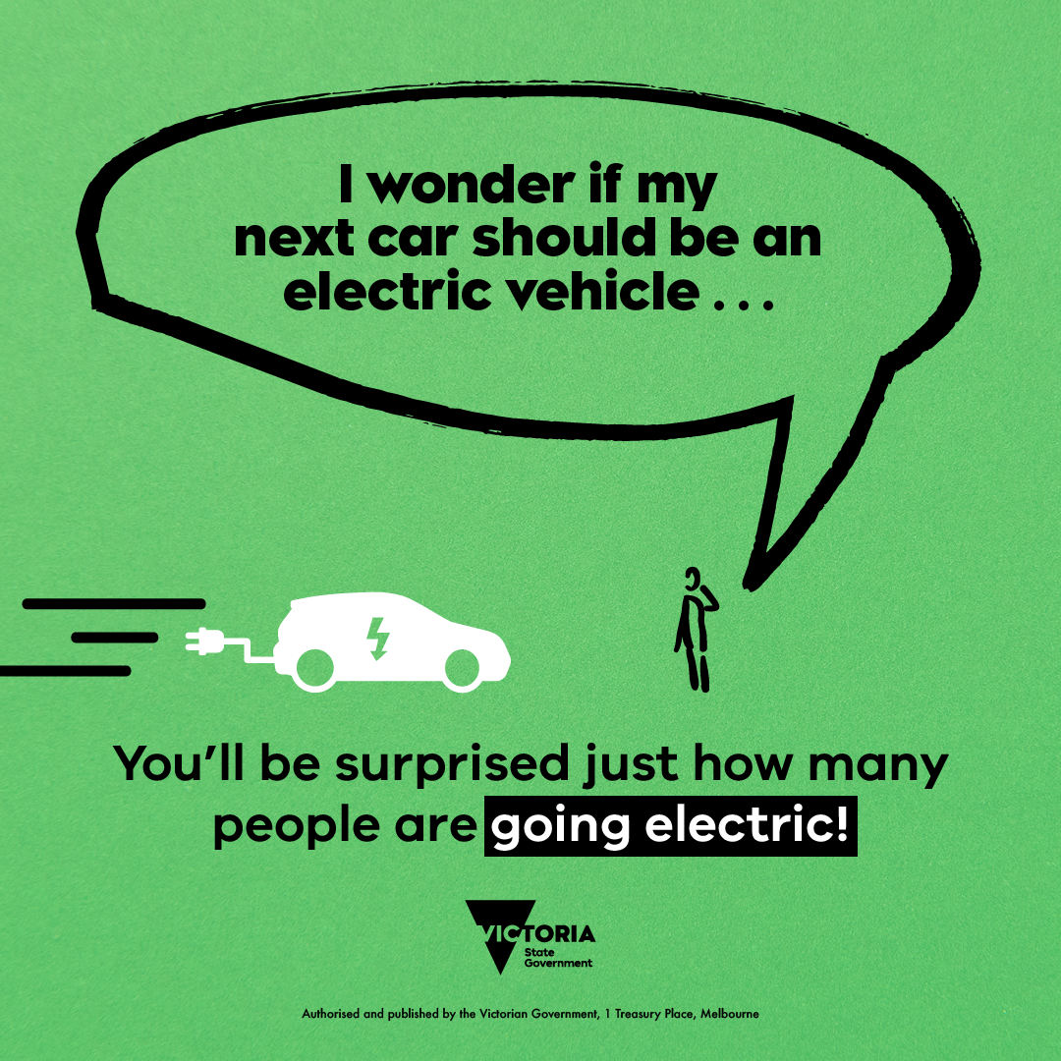
Be Surprised post 6 – going electric
File: ZEV Be Surprised – going electric.png
Post copy:
Are you considering the switch to electric? 🚙
With their many benefits - environmental, economical and technological – electric vehicles are the future. And with a $3,000 subsidy when you buy a model under $68,740, now is a great time to make the switch 💲
Accelerating the adoption of this exciting new technology, the Victorian Government has set a target of 50% of all new light vehicle sales to be zero emissions vehicles by 2030, making it the perfect time to go clean and green 💚
Get the facts on electric vehicles at www.energy.vic.gov.au/zev-facts
Are you considering the switch to electric? 🚙 With their many benefits - environmental, economical and technological – electric vehicles are the future. And with a $3,000 subsidy when you buy a model under $68,740, now is a great time to make the switch 💲 Accelerating the adoption of this exciting new technology, the Victorian Government has set a target of 50% of all new light vehicle sales to be zero emissions vehicles by 2030, making it the perfect time to go clean and green 💚
Get the facts on electric vehicles at www.energy.vic.gov.au/zevfacts
Mock-up only

